Slide 1
Chapter 11
Chapter 11
Data Link Control
(DLC)
Data Link Control
(DLC)

Slide 2
Chapter 11: Outline
11.1 DLC SERVICES
11.2 DATA-LINK LAYER PROTOCOLS
11.3 HDLC
11.4 PPP

Slide 3
Chapter 11: Objective
The first section discusses the general services provided by the DLC sublayer. It first describes framing and two types of frames used in this sublayer. The section then discusses flow and error control. Finally, the section explains that a DLC protocol can be either connectionless or connection-oriented..
The second section discusses some simple and common data-link protocols that are implemented at the DLC sublayer. The section first describes the Simple Protocol. It then explains the Stop-and-Wait Protocol.

Slide 4
Chapter 11: Objective
The third section introduces HDLC, a protocol that is the basis of all common data-link protocols in use today such as PPP and Ethernet. The section first talks about configurations and transfer modes. It then describes framing and three different frame formats used in this protocol.
The fourth section discusses PPP, a very common protocol for point-to-point access. It first introduces the services provided by the protocol. The section also describes the format of the frame in this protocol. It then describes the transition mode in the protocol using an FSM. The section finally explains multiplexing in PPP.

Slide 5
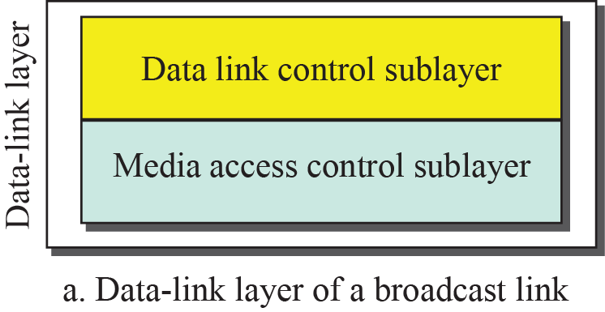
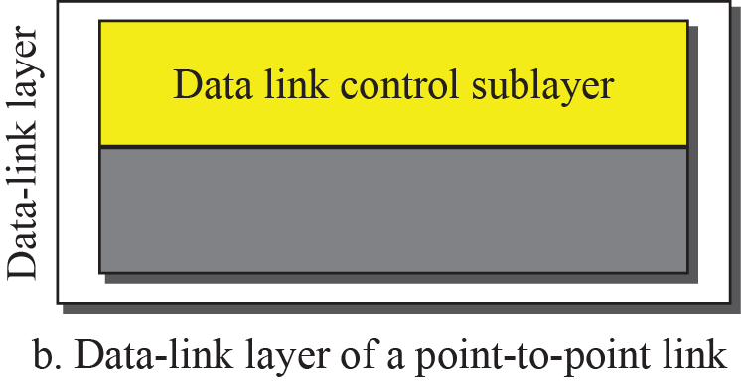
11.1 DLC Services
Data Link Control (DLC)
  DLC deals with procedures for communication between two adjacent nodes no matter whether the link is dedicated or broadcast.
DLC Services
  Data link control functions include framing and flow & error control.
Fig. 9.4: Dividing the data-link layer into two sublayers

Slide 6
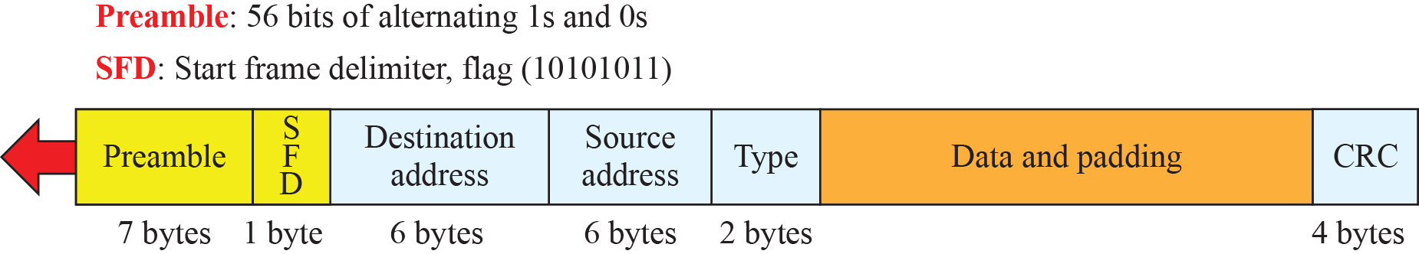
11.1.1 Framing
Framing
  Data-link Layer packs bits into frames to distinguish from another.
  Framing means how to organize the bits that are carried by the physical layer.
  Framing separates a packet by adding a sender and destination address.
Ethernet Frame

Slide 7
11.1.1 Framing
Frame Size
  Fixed-size Framing – used in ATM or WAN
    No need for defining the boundaries of the frames.
  Variable-size Framing – used in LAN
    Need to define the end of one frame and the beginning of the next.
    Two approach : Byte-oriented Framing and Bit-oriented Framing

Slide 8
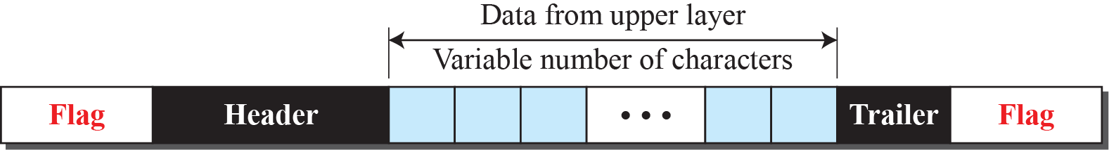
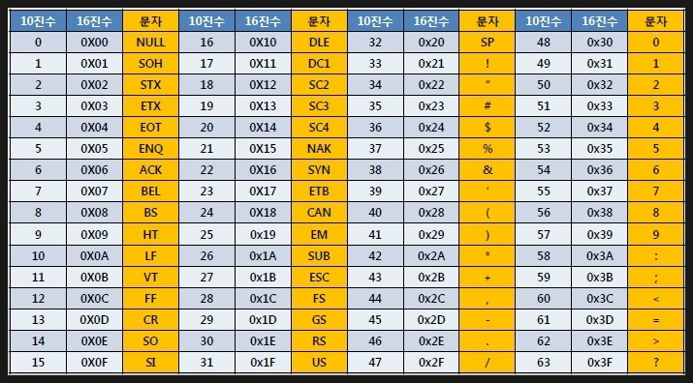
11.1.1 Framing
Byte Oriented Framing

Slide 9
11.1.1 Framing
Byte (Character) Oriented Framing
  The data to be carried are 8-bit characters such as ASCII.
  To separate one frame from the next, an 8-bit(1-byte) Flag is added.
    The Flag is composed of protocol dependent special characters.
  Any character used for the Flag could also be part of the information such as graphs, audio and video.
    Byte Stuffing is used to solve this problem.

Slide 10
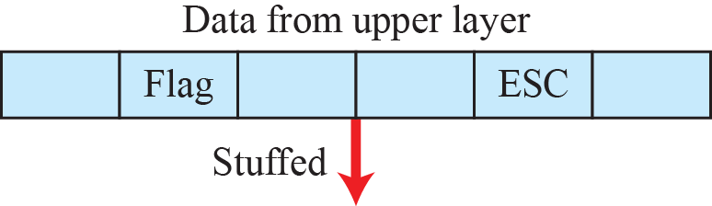
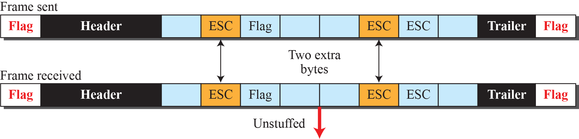
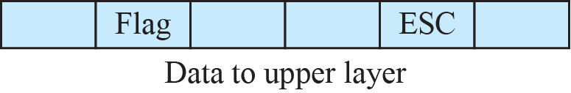
11.1.1 Framing
Byte Stuffing
  Byte stuffing is the process of adding 1 extra byte whenever there is a flag or escape character in the text.

Slide 11
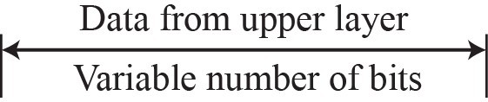
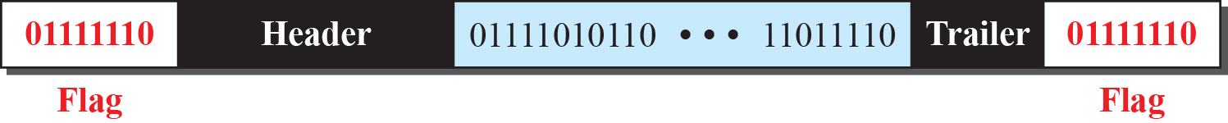
11.1.1 Framing
Bit Oriented Framing
  The data section of a frame is a sequence of bits as text, graph, audio, video, and so on.
  Most protocols use 8-bit pattern flag, 01111110 , as the delimiter.

Slide 12
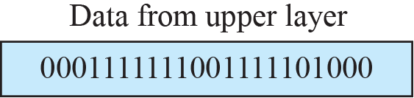
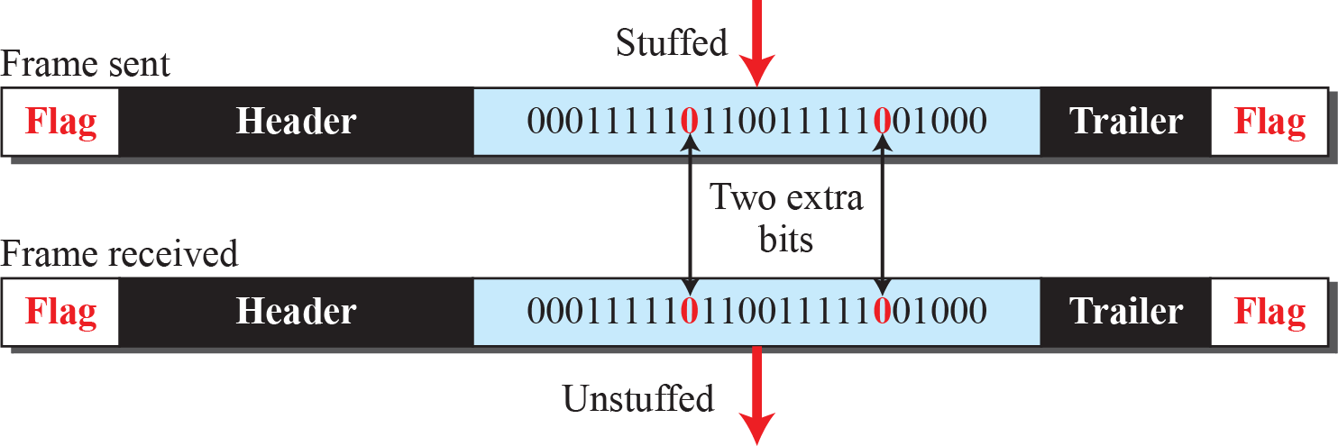
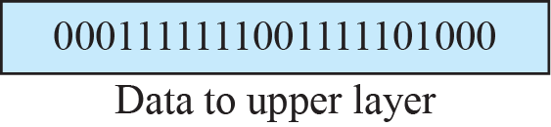
11.1.1 Framing
Bit Stuffing
  Bit stuffing is the process of adding one extra 0 whenever five consecutive 1s follow a 0 in the data.
  The receiver does not mistake the pattern 0111110 for a flag.

Slide 13

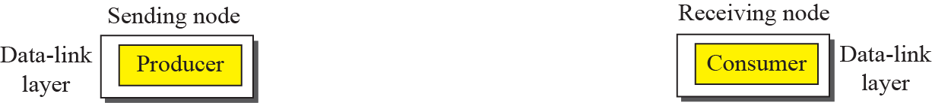
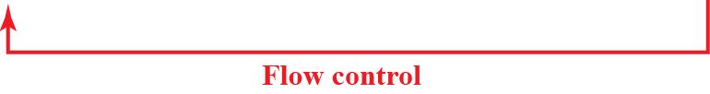
11.1.2 Flow and Error Control
Flow Control
  Whenever an entity produces items and another entity consumes them, there should be a balance between production and consumption rate.
  One way of implementing the flow control is to use two buffers.
Flow control at the data link layer

Slide 14
11.1.2 Flow and Error Control
3 Flow Control Mechanism
  Xon/Xoff Protocol
    It is a software flow control method of flow control used in computer data links, especially RS-232 serial.
    It is used extensively by low-speed devices, especially older printers and dumb terminals, to indicate they are temporarily unable to accept more data.
  Stop-and-Wait Protocol
    It sends one frame at a time and used in Datalink Layer.
  Sliding Window Protocol
    It send several frames at a time and used in Transport Layer.

Slide 15
11.1.2 Flow and Error Control
Error Control
  For the error control at the data link layer, a CRC is added to the frame header at the sender.
  Two method of Error Control
    If the received frame is corrupted, the frame is discarded.
    If the received frame is not corrupted, an acknowledge is sent to the sender.
Combination of Flow and Error Control
  Flow and error control can be Combined.

Slide 16
11.1.3 Connectionless and Connection Oriented
Connection
  Connectionless Oriented Protocol
    The frames are sent without any relationship between the frames ➔ Each frame is independent.
    Most of the data-link protocols for wired LAN
  Connection Oriented Protocol
    ①Logical connection setup between two nodes ➔ ②All frames are transferred ➔ ③Termination of logical connection
    The frames are numbered and sent in order.
    Some point-to-point protocol, wireless LAN, some WAN

Slide 17
11.2 Datalink Layer Protocol
Four protocols have been defined for the data-link layer to deal with flow and error control.
  Simple protocol
  Stop-and-Wait protocol
  Go-Back-N protocol using sliding window
  Selective-Repeat protocol using sliding window
Although the first two protocols still are used at the data-link layer, the last two have disappeared.

Slide 18
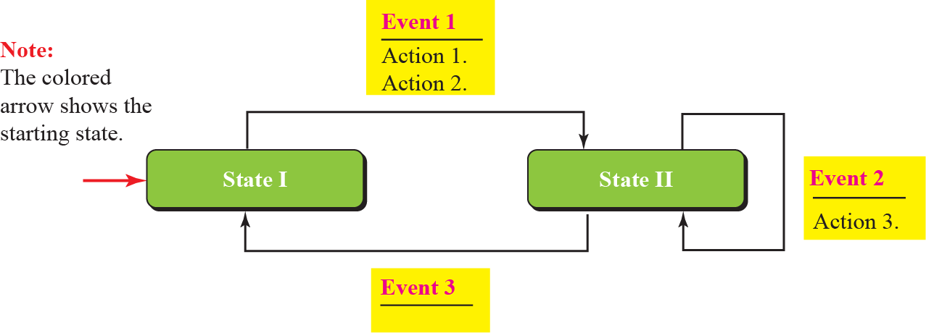
11.2 Datalink Layer Protocol
Connectionless and Connection Oriented Service represented as Finite State Machine (FSM)

Slide 19
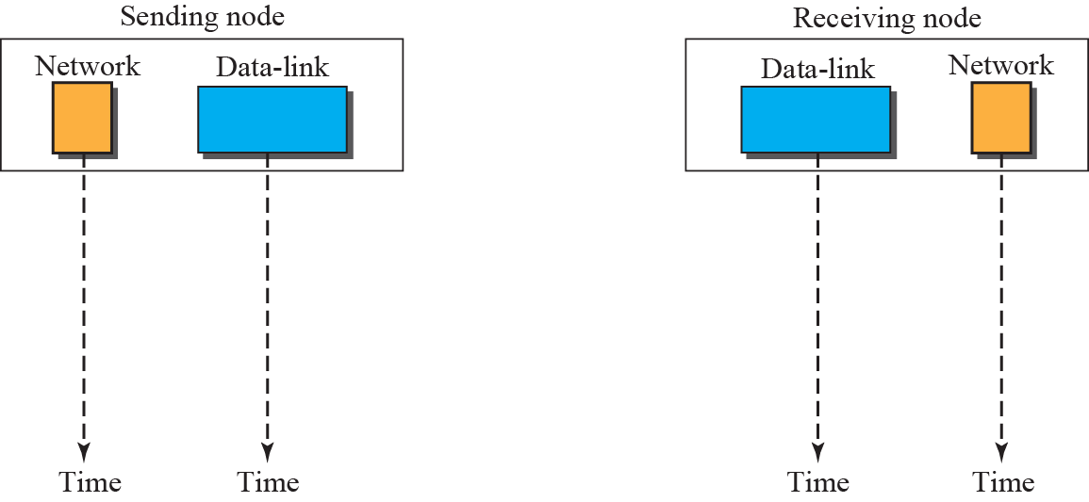

11.2.1 Simple Protocol
Simple Protocol
  A simple protocol has neither flow nor error control.
  We assume that the receiver can immediately handle any frame it receives.

Slide 20
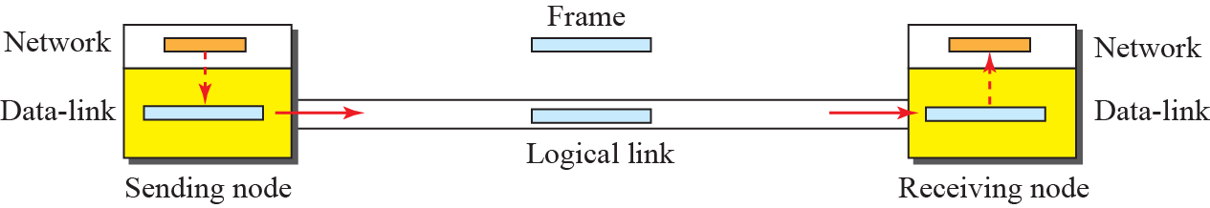
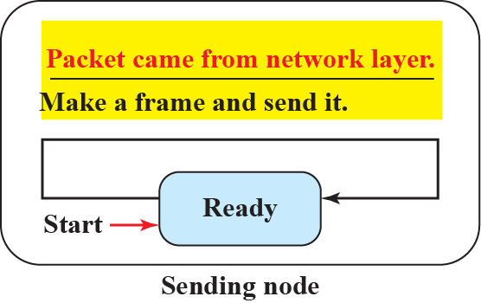
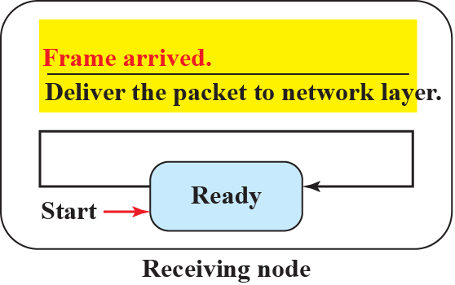
11.2.1 Simple Protocol
Simple Protocol

Slide 21
11.2.2 Stop & Wait Protocol
Stop & Wait Protocol
  The Stop-and-Wait protocol uses both flow and error control.
  The sender sends one frame at a time and waits for an acknowledgment before sending the next one.
  To detect corrupted frames, we need to add a CRC to each data frame.
    수신측에서 CRC가 맞지 않으면 프레임은 손상된 것이며 폐기함
    수신자의 침묵은 프레임이 손상되거나 손실되었다는 신호

Slide 22
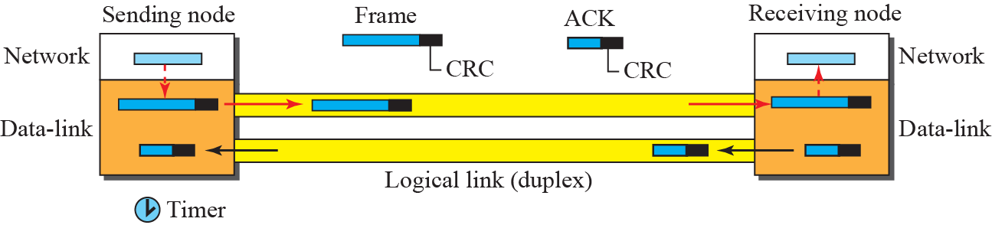
11.2.2 Stop & Wait Protocol
Stop & Wait Protocol
  Every time the sender sends a frame, it starts a timer.
    타이머 종료 전에 확인응답이 오면 타이머를 중지하고 다음 프레임 전송
    타이머가 종료되면 송신자는 이전 프레임을 재전송
  The sender needs to keep a copy of the frame until its acknowledgement arrives.

Slide 23
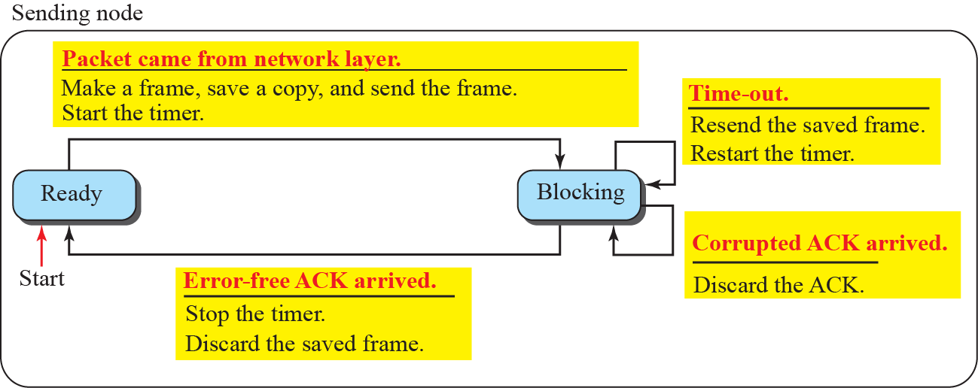
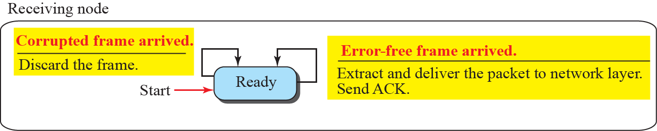
11.2.2 Stop & Wait Protocol
Stop & Wait Protocol

Slide 24
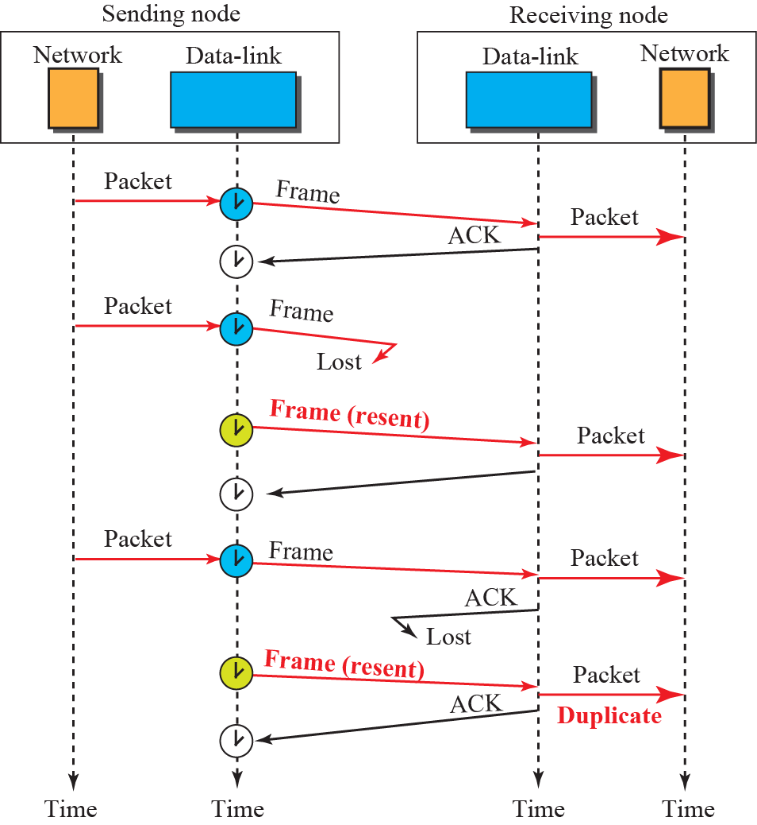
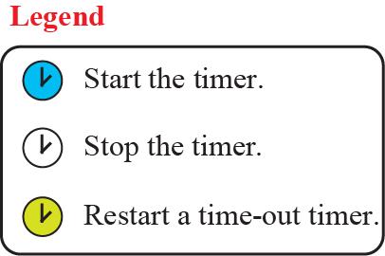
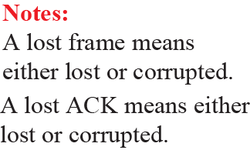
11.2.2 Stop & Wait Protocol
Example 11.3

Slide 25
11.2.2 Stop & Wait Protocol
Example 11.3
  The first frame is sent and acknowledged.
  The second frame is sent, but lost.
    After time-out, it is resent.
  The third frame is sent and acknowledged, but the acknowledgment is lost.
    The frame is resent.
    The receiver site receives two copies of the third packet, which is not right.
    ➔ we can correct this problem using sequence numbers and acknowledgment numbers.

Slide 26
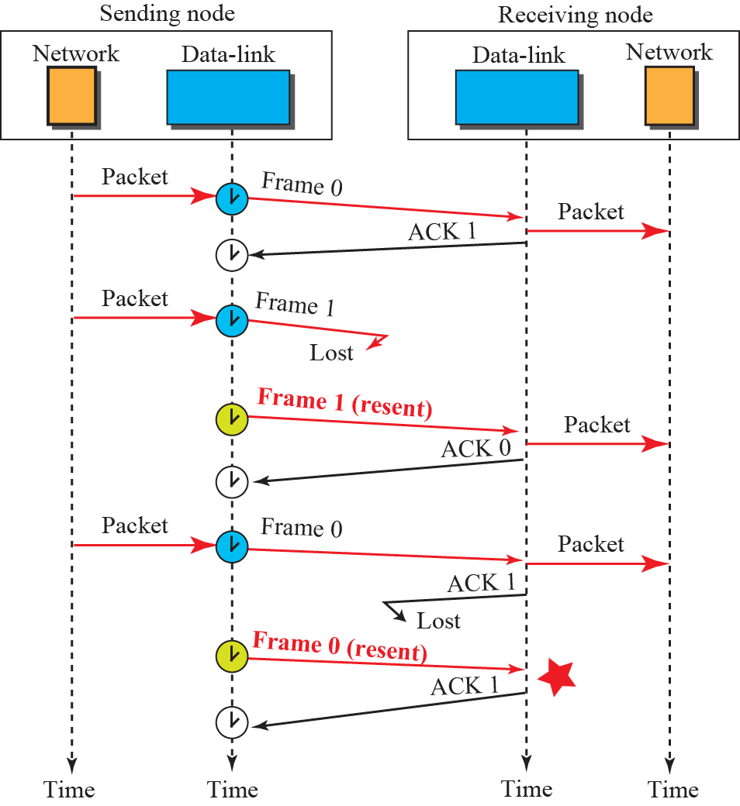

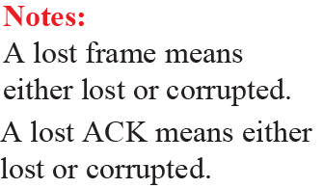
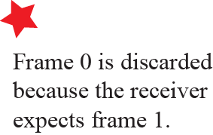
11.2.2 Stop & Wait Protocol
Example 11.4

Slide 27
11.2.2 Stop & Wait Protocol
Example 11.4 : Stop & Wait Protocol with Frame Sequence Number
  The adding of sequence and acknowledgment numbers can prevent duplicates.
  The first frame is sent and acknowledged.
  The second frame is sent, but lost.
    After time-out, it is resent.
  The third frame is sent and acknowledged, but the acknowledgment is lost.
    The frame is resent.

Slide 28
11.2.3 Piggybacking
The two protocols we discussed in this section are designed for unidirectional communication.
  data is flowing only in one direction although the acknowledgment may travel in the other direction.
Protocols have been designed to allow data to flow in both directions.
  To make the communication more efficient, the data in one direction is piggybacked with the acknowledgment in the other direction.

Slide 29
Synchronous / Asynchronous Serial Communication
Asynchronous Protocols :
  The endpoints' interfaces are not synchronized by a common clock signal.
  The data stream contains synchronization information in form of start and stop signals.
  Asynchronous start-stop signaling was widely used for dial-up modem access
Stop Bits (2)
Data
Bit 1
Data
Bit 3
Data
Bit 6
Parity
Bit
HIGH
LOW
Start
Bit
Data
Bit 0
Data
Bit 2
Data
Bit 4
Data
Bit 5
Data
Bit 7

Slide 30
Synchronous / Asynchronous Serial Communication
Synchronous Communication :
  It requires that the clocks in the transmitting and receiving devices are synchronized – running at the same rate.
    The receiver can sample the signal at the same time intervals used by the transmitter.
    No start or stop bits are required.
  It is divided by two classes.
    Byte-oriented Protocol : BSC (Binary synchronous communication Protocol)
    Bit-oriented Protocol : HDLC(High-level Data Link Control)

Slide 31
11.3 HDLC
High-level Data Link Control(HDLC) Protocol
  HDLC is a bit-oriented protocol for communication over point-to-point and multipoint links.
  It implements the Stop-and-Wait protocol.
  Most of the concept defined in HDLC is the basis for other practical protocols such as PPP, Ethernet, or wireless LANs.

Slide 32
11.3.1 Configuration and Transfer Modes
Classification of Station
  Primary station can send commands.
  Secondary station can only respond.
  Combined station : Each station can function as a primary and a secondary (acting as peers).
Configuration of Station
  Unbalanced Configuration
    One primary node and many secondary nodes
  Balanced Configuration
    The link is point-to-point and each station is acting as peers.

Slide 33
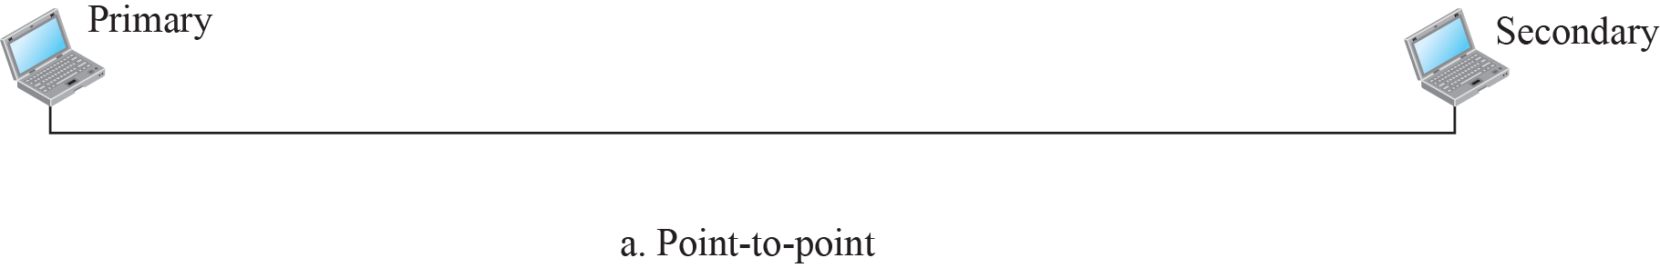


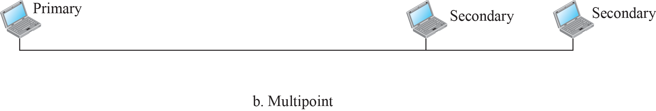
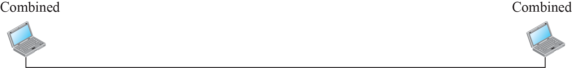


11.3.1 Configuration and Transfer Modes
Two common transfer modes
  Normal Response Mode (NRM)
  Asynchronous Balanced Mode (ABM).
The station configuration is unbalanced
The station configuration is balanced

Slide 34
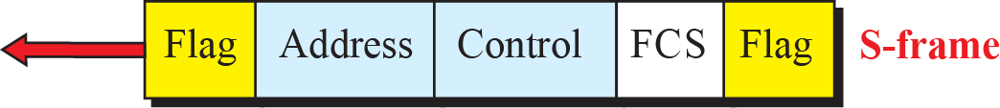
11.3.2 Framing
HDLC defines three types of frames.
  Information Frame (I-Frame)
    It transports user data to an other node.
  Supervisory Frame (S-Frame)
    For flow and error control whenever piggybacking is impossible.
  Unnumbered Frame (U-Frame)
    For various miscellaneous purposes, including link management.
1 1 1 or 2 variable length 2 or 4 1 Byte
01111110
01111110

Slide 35
11.3.2 Framing
The Field of HDLC Frame
  Flag Field identifies the beginning and the end of a frame. (01111110)
  Address Field contains the address of secondary station.
  Control Field is used for flow and error control.
  Information Field contains user’s data.
    It’s length can vary on depending the network.
  FCS(Frame Check Sequence) Field is error detection field.
  (2 or 4 bytes CRC)

Slide 36
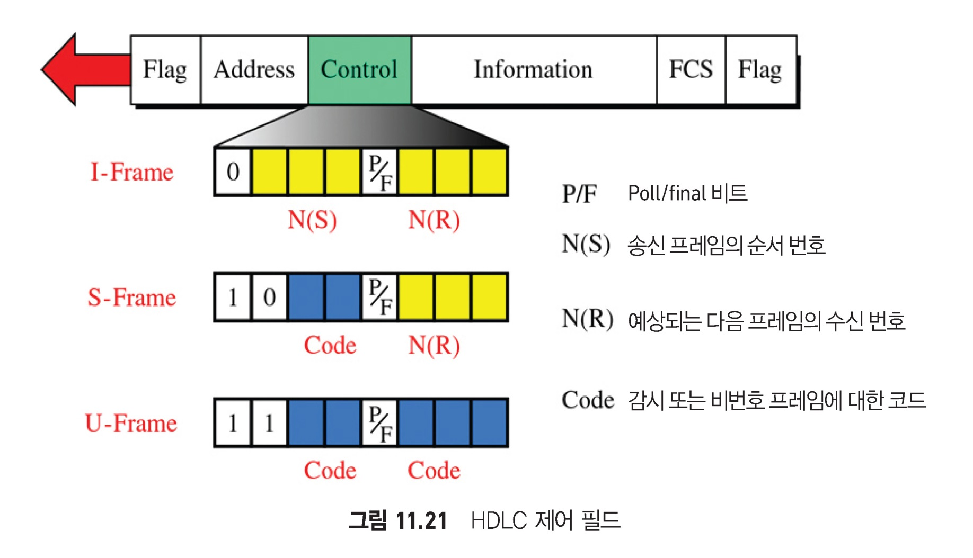
11.3.2 Framing
Control field format for the different frame types
Poll/Final bit
Sequence number of the frame
Acknowledgement number of the frame
Type of a control frame

Slide 37

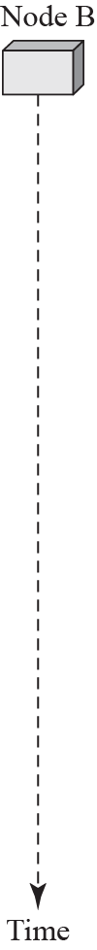
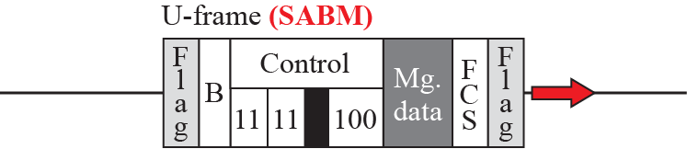
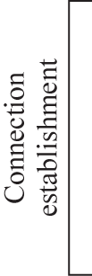
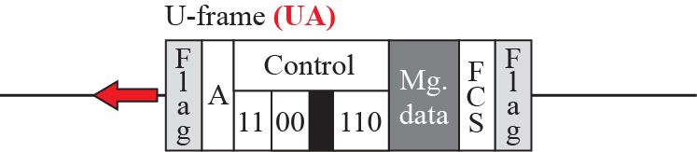

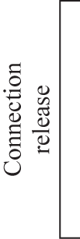
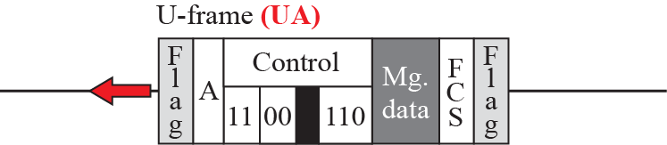
11.3.2 Framing
Example of U-frames
  Connection
  disconnection

Slide 38
11.3.2 Framing
Poll/Final Bit
  It has meaning only when it is set (bit = 1).
    Poll : Primary → Secondary (Command)
    Final : Secondary → Primary (Response)
Poll
Poll

Slide 39
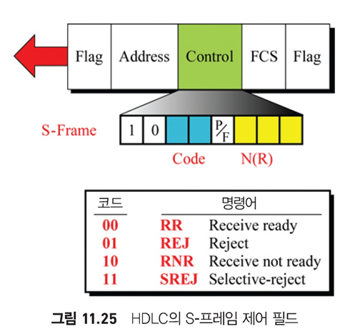
11.3.2 Framing
Control field of S-Frame

Slide 40
11.3.2 Framing
RR(Receive Ready) : 00
  It acknowledges the receipt of a safe frame.
  N(R) defines acknowledgement number.
RNR(Receive Net Ready) : 10
  It announces that the receiver is busy and cannot receive more frame.
  N(R) defines acknowledgement number.
REJ(Reject) : 01
  This is NAK frame to define that the last frame is lost or damaged. (Go-back-N ARQ)
  N(R) is negative acknowledgement number.
SREJ(Selective-Reject) : 11
  This is NAK frame to define that the last frame is lost or damaged. (Selective Reject ARQ)
  N(R) is negative acknowledgement number.

Slide 41
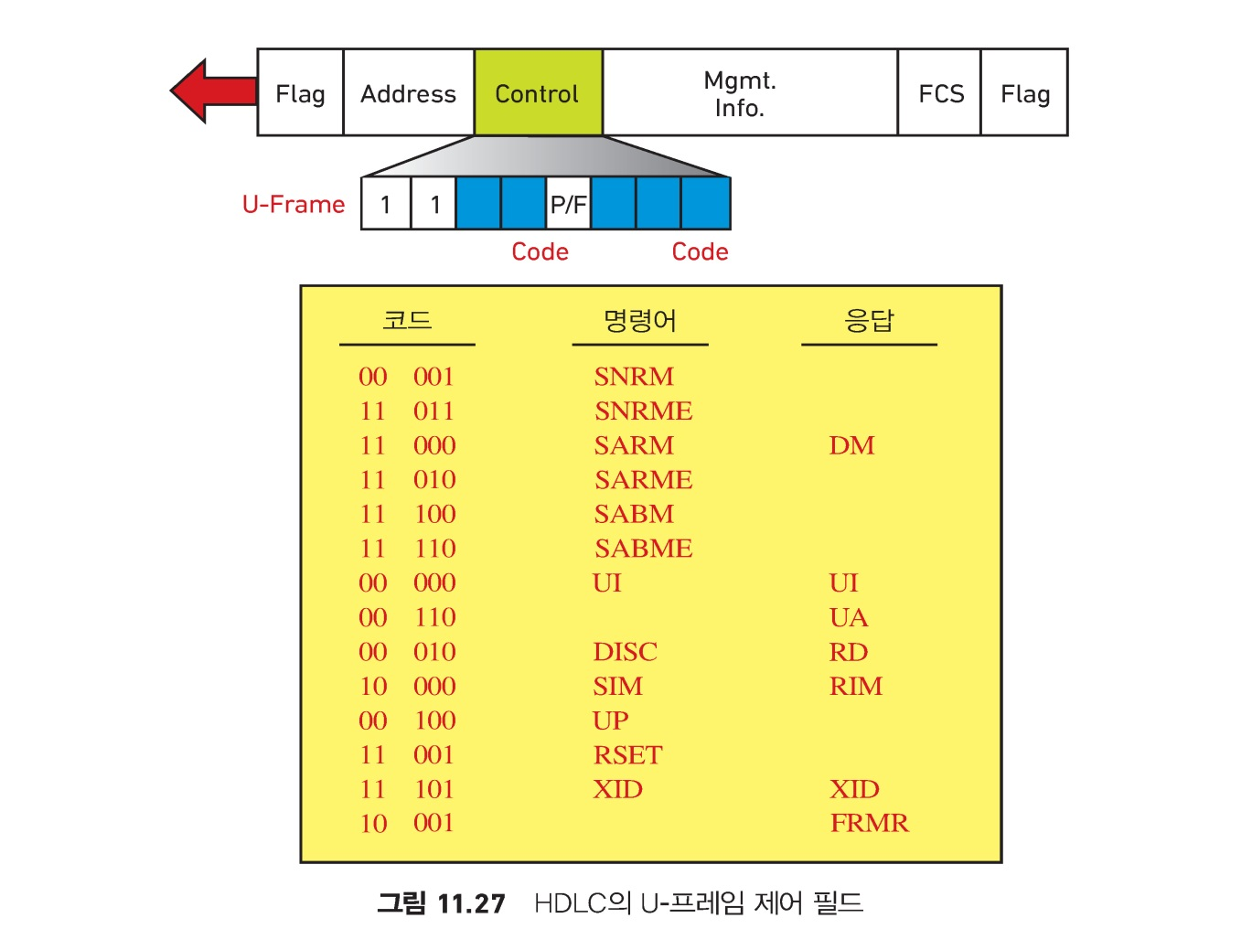
11.3.2 Framing
Control field of U-Frame

Slide 42
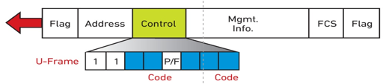
11.3.2 Framing
U-Frame
  It is used to exchange session management and control information.
  Logical link between primary and secondary Station
    00 001 : SNRM(Set Normal Response Mode)
    11 000 : SARM(Set Asynchronous Response Mode)
    11P100 : SABM(Set Asynchronous Balanced Mode)
    11P010 : DISC(Disconnect) : 논리적 링크 접속 종료
    00F110 : UA(Unnumbered Acknowledgement) : 긍정 응답
    11F000 : DM(Disconnected Mode) 부정 응답

Slide 43
11.3.2 Framing
How U-frames can be used for connection establishment and connection release?
  Node A asks for a connection with a set SABM (asynchronous balanced mode) frame; node B gives a positive response with an unnumbered acknowledgment (UA) frame.
  After these two exchanges, data can be transferred between the two nodes (not shown in the figure).
  After data transfer, node A sends a DISC (disconnect) frame to release the connection; it is confirmed by node B responding with a UA (unnumbered acknowledgment).

Slide 44
11.3.2 Framing
Example of connection and disconnection

Slide 45
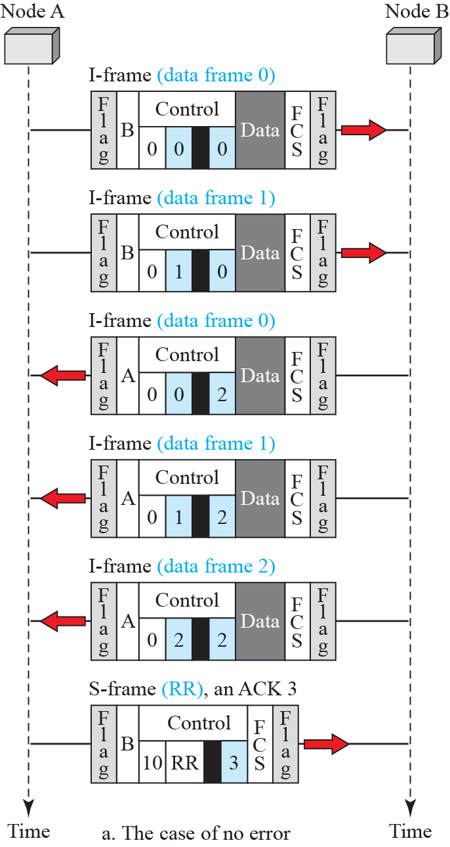
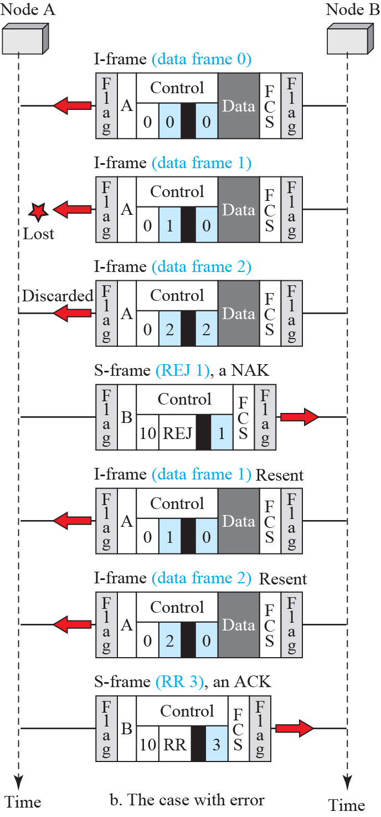
Example of piggybacking with and without error
some frames are discarded.
01
00
00

Slide 46
11.4 Point-to-Point Protocol(PPP)
Point-to-Point Protocol (PPP).
  PPP is a data link protocol used to establish a direct connection between two nodes. (point-to-point access)
  PPP is by far the most common protocols for point-to-point access.
Internet service providers (ISPs) have used PPP for customer dial-up access to the Internet.
  Why PPP is needs to access Internet?
  IP packets cannot be transmitted over a modem line on their own, without some data link protocol.

Slide 47
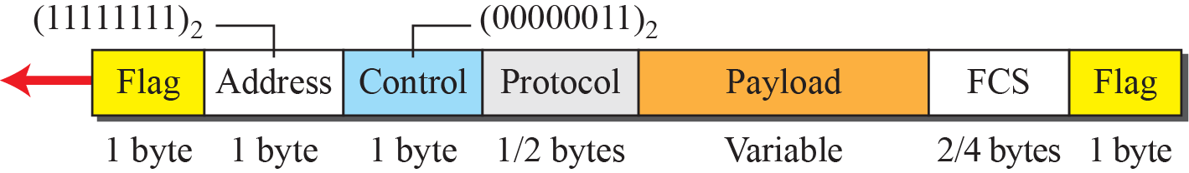
11.4.2 Framing
PPP Frame Format
  PPP frames are variants of HDLC frames.
  Flag field indicates frame's begin or end.
  (The value is 01111110)
  Address field use broadcast address. (11111111)
  Control field is set to constant value 00000011.
  Protocol field defines what is being carried in the data field.
  Payload field carries User datagram or other information.
  Frame Check Sequence(FCS) field) : error check

Slide 48

11.5 Summary
The general services provided by the DLC sublayer.
  Flow and error control
  Framing
data-link protocols
  Simple Protocol
  Stop-and-Wait Protocol.
HDLC
  Configurations and transfer modes
  Framing and three different frame formats
PPP
  for point-to-point access

